Slide 1
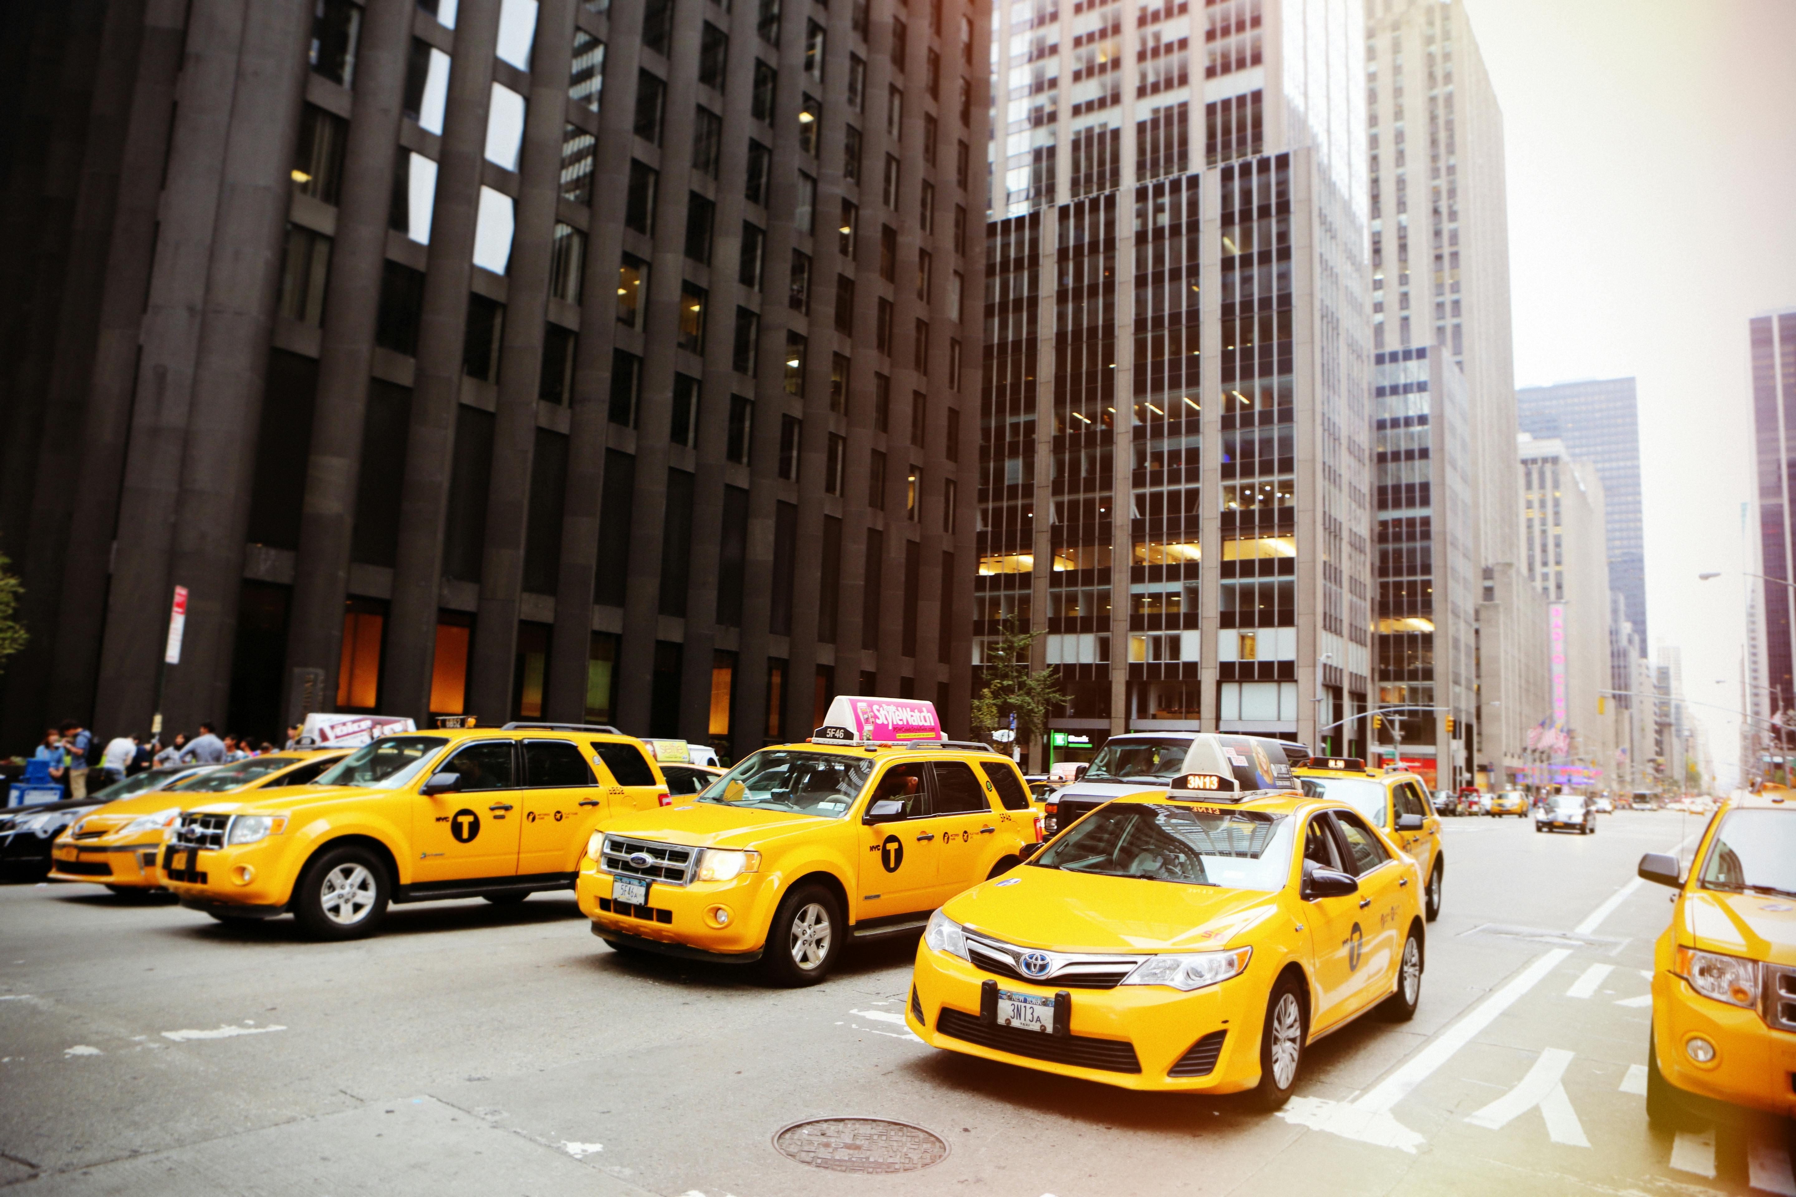
Power BI Project NYC Taxi Trip Dashboard Data: May - June 2020

Slide 2
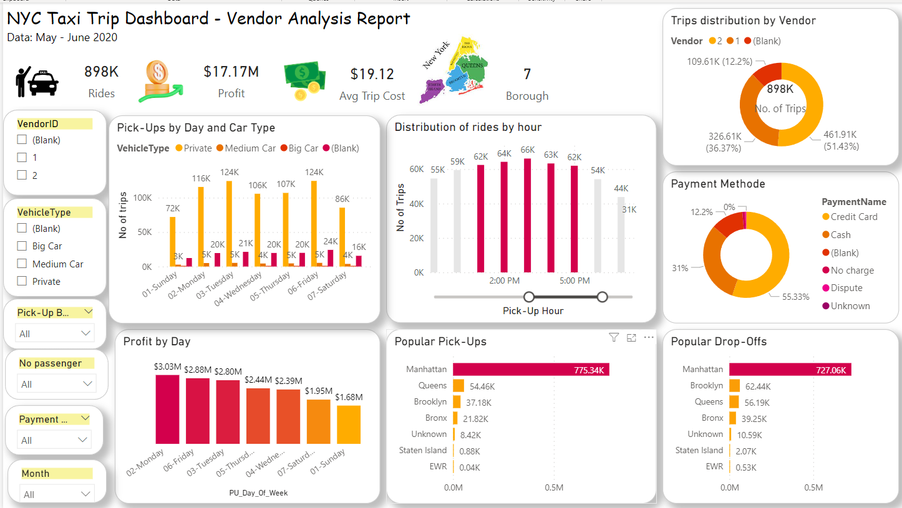

Slide 3
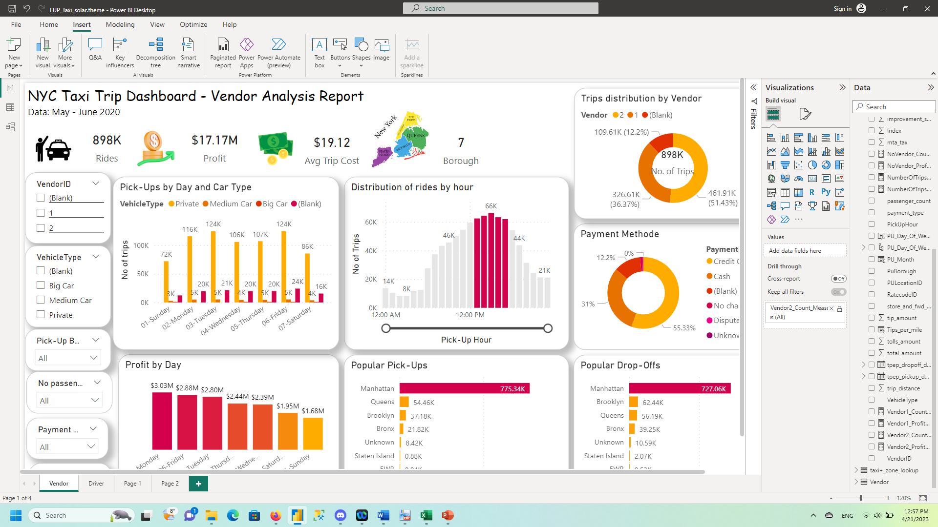
Vendor Analysis Report - What is the distribution of vehicle types by day of the week?
Conclusions:
- Private Cars make the most pick-ups – most popular days being Friday and Tuesday, with 124K rides
- Medium Cars are used to approximately the same extent every day
- Blank type of cars are rides that have no records or 0 number of person. Friday is the day with the most Blank Type of car, namely 24K rides.
- Big Cars are very unpopular, with only 4 trips recorded.
Recommendation:
- Implement a change in the way the drivers can report the number of person per ride, namely introducing a dropdown list in order to eliminate the no records or 0 values.
- Add an ecology tax for private rides, to encourage ride sharing, reduce carbon outputs, and increase the use of larger cars.

Slide 4
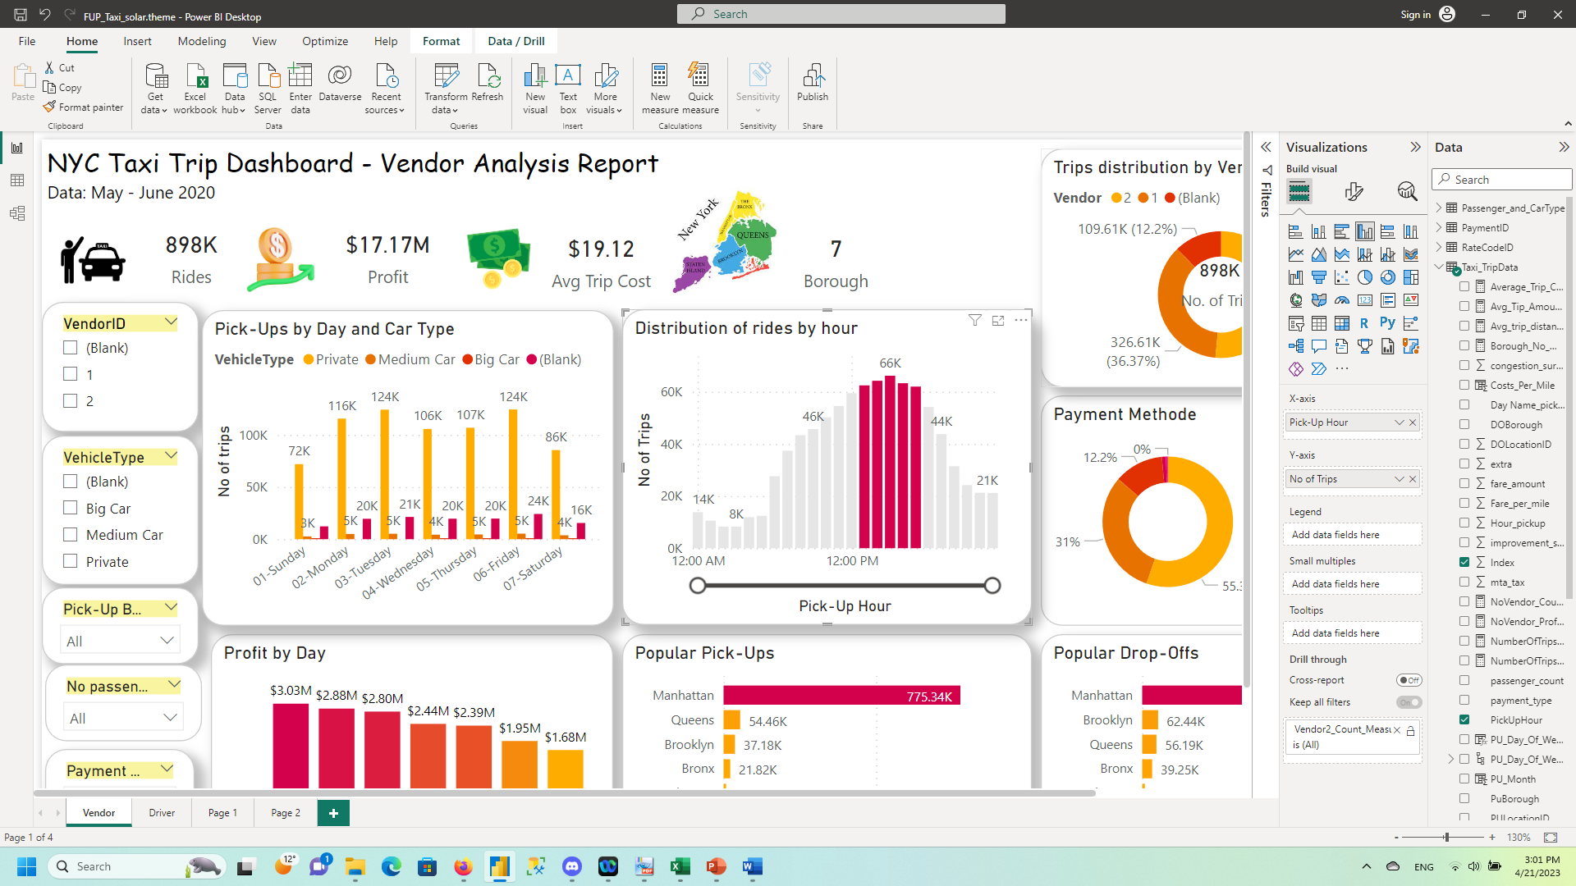
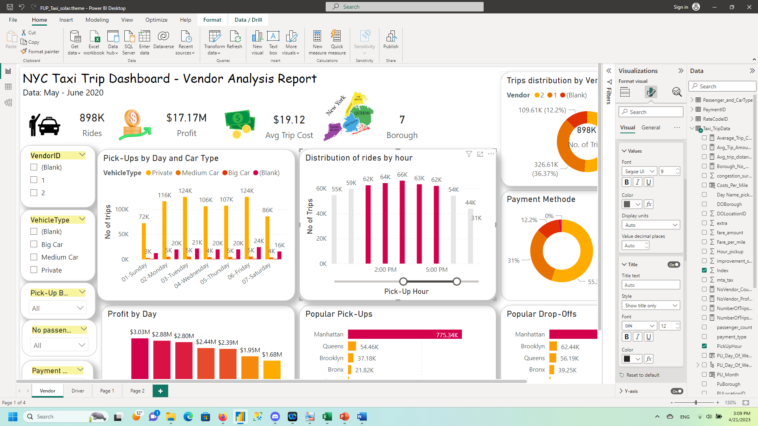
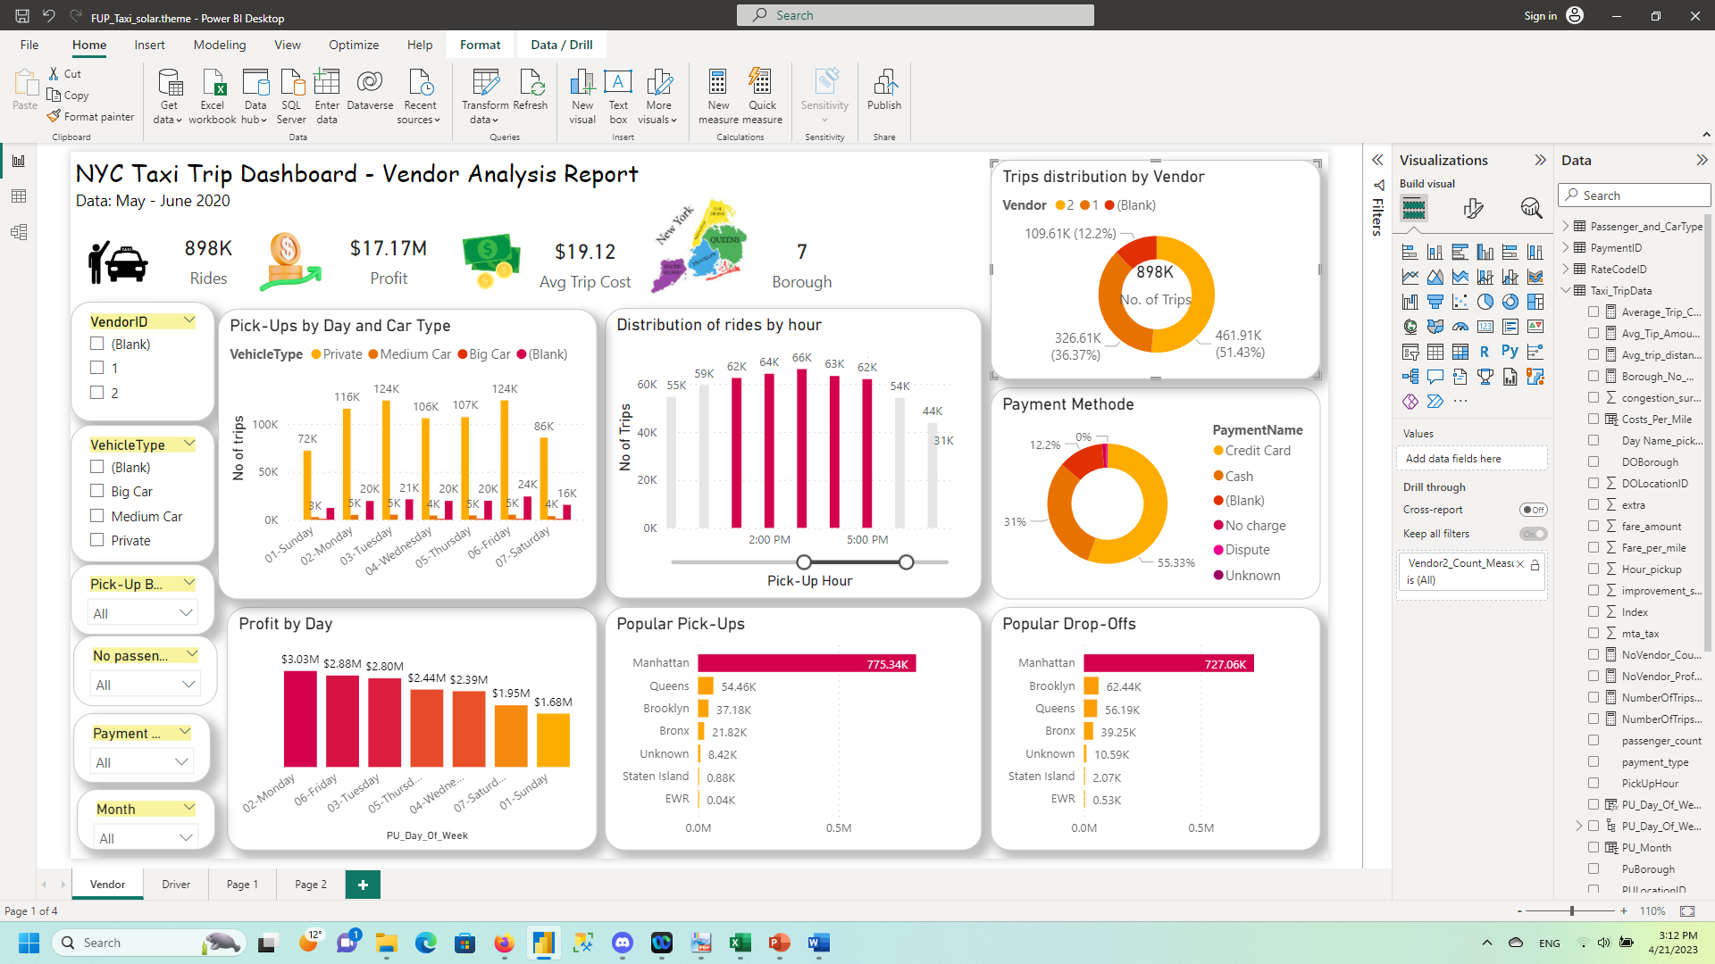
- Which is the most popular vendor?
- Which five hours a day, on average, have the most starting times for rides?
Conclusions:
On average, the most starting times for rides are:
15, 14, 16, 13, and 17, in descending order.
Recommendation:
For the time interval 13:00 to 18:00, there should be a 5% traffic surcharge on the costs, to increase profits.
Conclusions:
- Vendor 2 – VeriFone Inc. is the most popular vendor, with 51% from total rides.
- Vendor 1 – Creative Mobile Technologies provides 36% of total rides.
- We have a 12% from all rides that have no records. We can assume that these are spontaneous rides, not assigned by any Vendor, the Taxi driver picked up the customers directly.
Recommendation:
Implement a change in the way the vendor is registered, namely introducing a value for spontaneous rides.

Slide 5
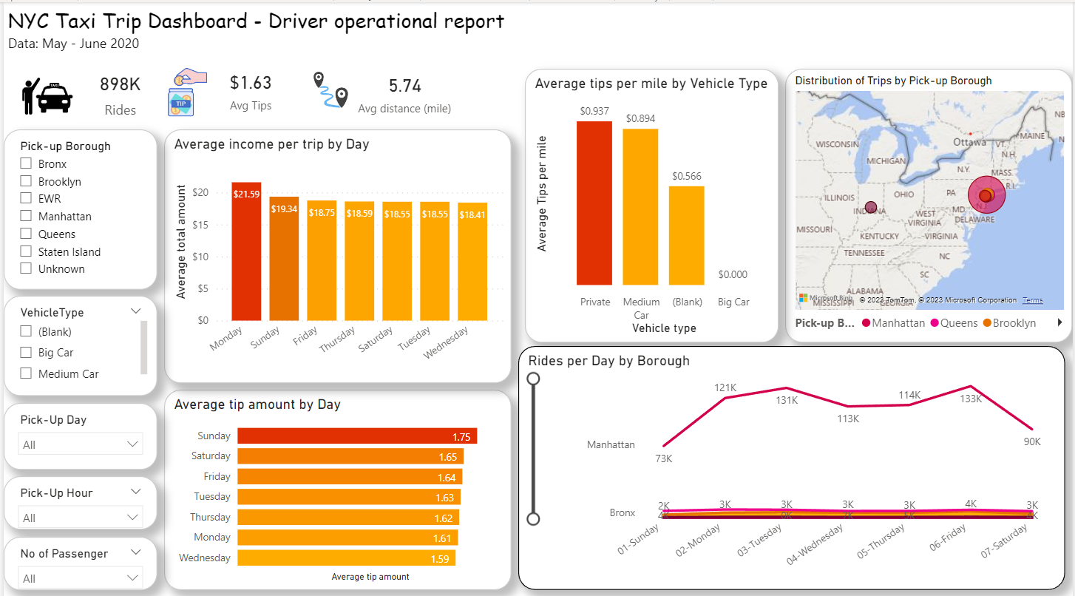

Slide 6
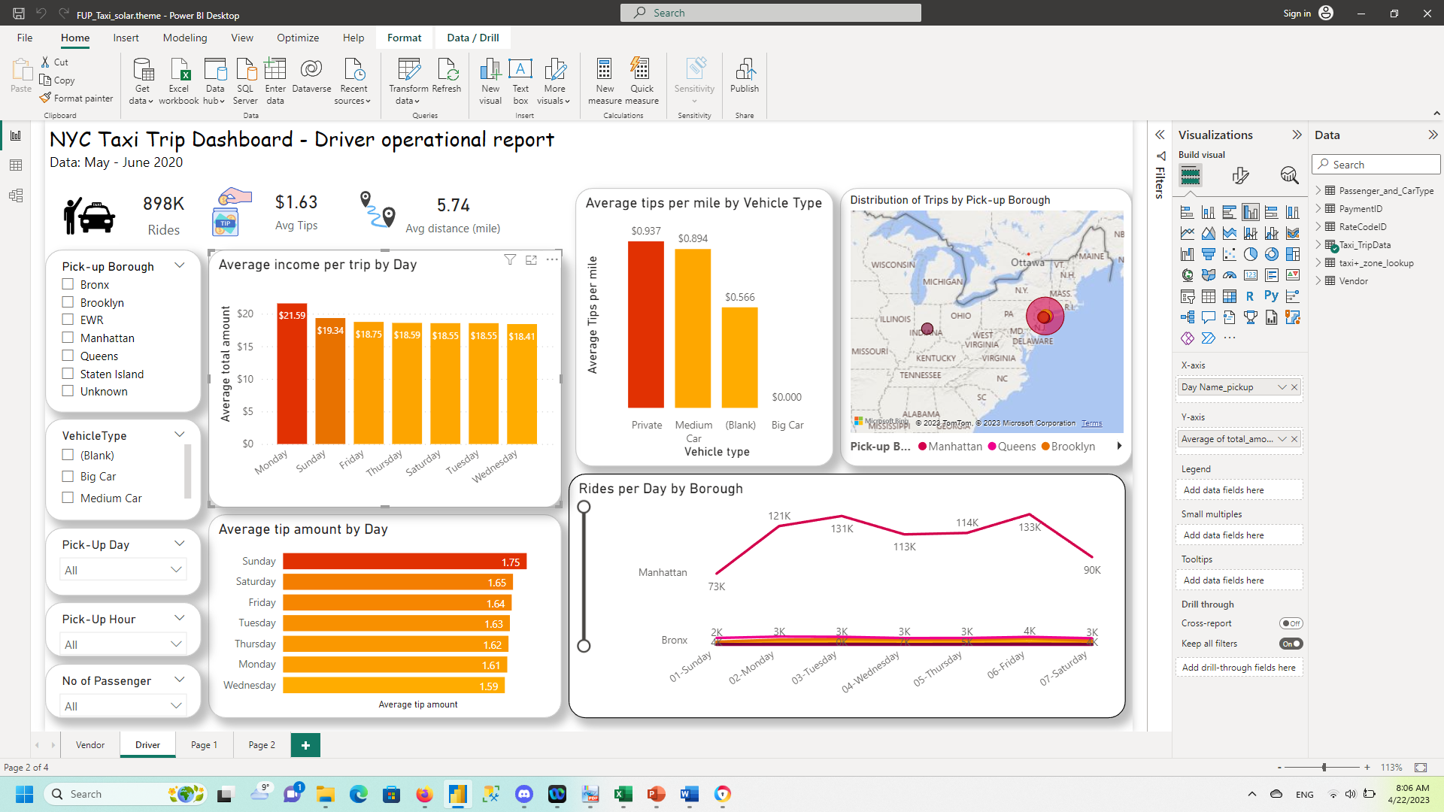
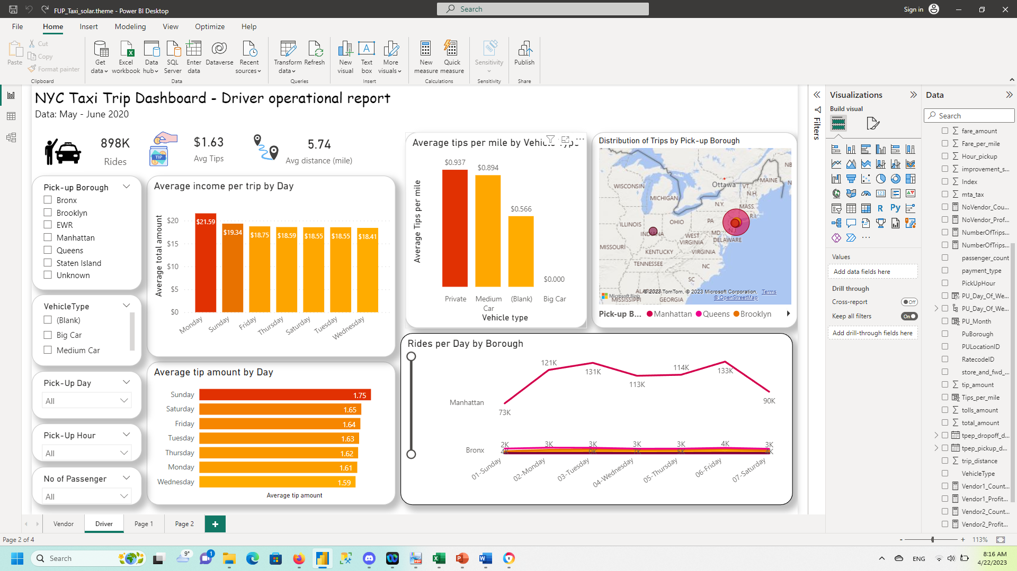
Driver operational report - What are the two days a week when the average income per trip is the highest?
Conclusions:
- Monday has the highest average income per trip ($21.59)
- Sunday has the second highest average income per trip ($19.34)
Recommendation:
Ensure that Private Cars and Medium Cars are available Monday and Sunday.
- What is the type of vehicle with the highest tip per mile (mile = unit of distance)
Conclusions:
On average, the highest tip per mile is for Private Car ($0.937 per mile), closely followed by the Medium Car ($0.984).
Recommendation:
Identify the tips that are not categorized (Average Tips by Companies -> Blank), for a more accurate reading.
Identify the vehicles that are not categorized properly due to lack of reporting. Incentivise reporting for employees.

Slide 7

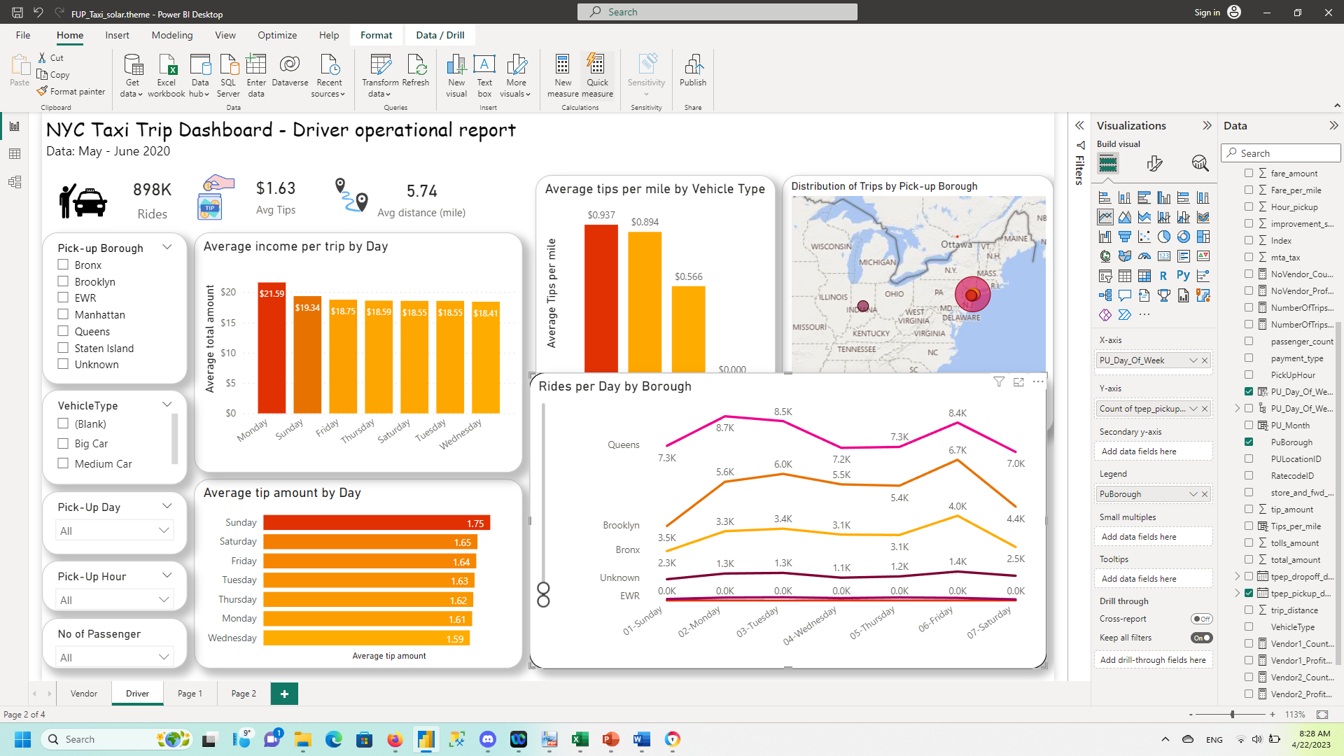
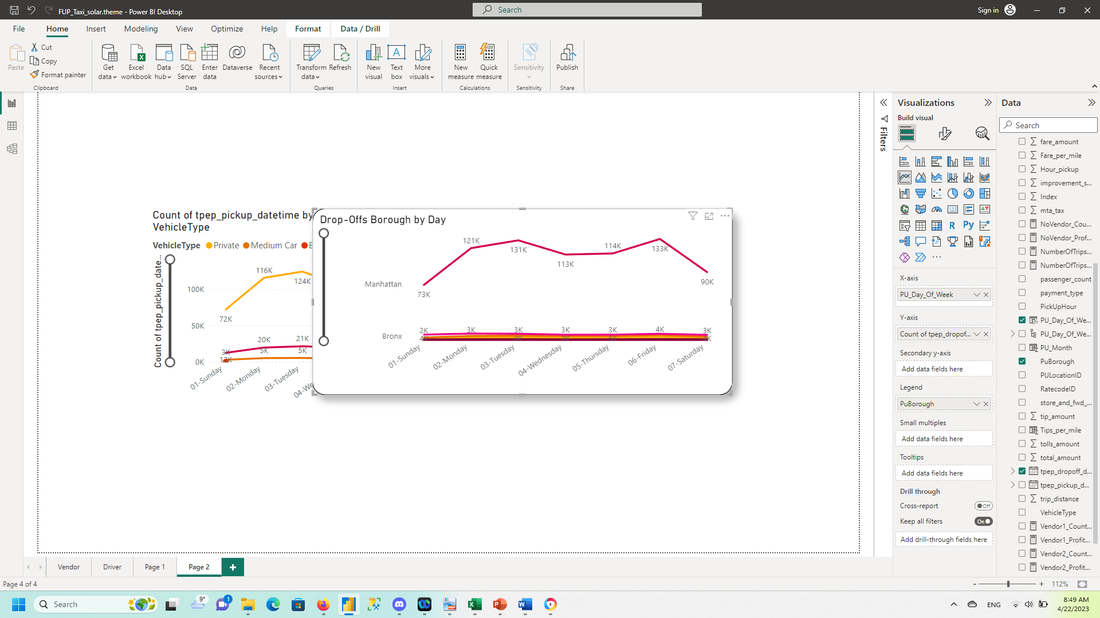
- Which is the most popular PICK-UP BOROUGH?
- Which is the most popular drop-off BOROUGH?
Conclusions:
Manhattan is clearly not only the most popular Pick-Up Borough but also Drop-off.

